Slide 1
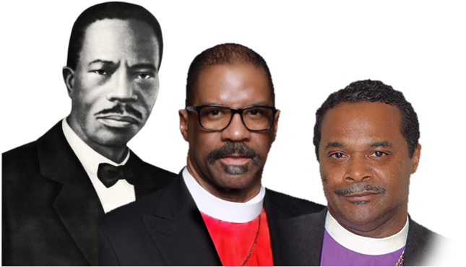
COGIC
10 YEAR
STRATEGIC
PLANNING
TOOLBOX
PROPOSAL

Slide 2
The saying has been attributed most often to Benjamin Franklin, who is also credited with having said,
“By failing to prepare, you are preparing to fail.”
More recent variations, along with their attributions, include:
“Fail to plan, plan to fail.”
Carl W. Buechner
“Failures don’t plan to fail; they fail to plan.”
Harvey MacKay
”He who fails to plan is planning to fail.”
Winston Churchill (during World War II)

Slide 3
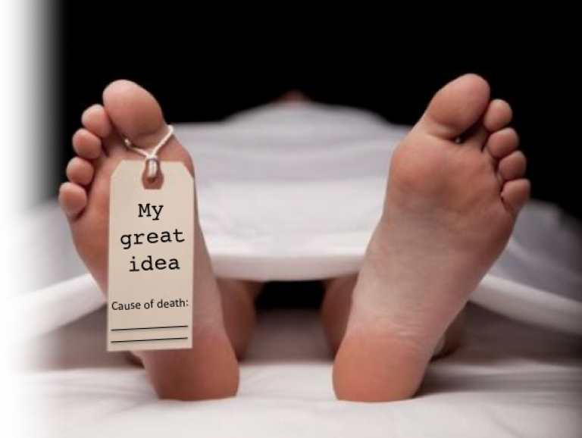
A pre-mortem —
also known as a premortem— is a managerial strategy in which a project team imagines that a project or organization has failed, and then works backward to determine what potentially could lead to the failure of the project or organization.

Slide 4
10 YEAR
STRATEGIC PLAN
20 YEAR
COMPREHENSIVE
MASTER PLAN
3 Years Organizational Thinking and Strategic Frame Working
7 Areas of Organizational Focus
Strategic Synopsis
Strategic Assessment
Executive Outline
General Assembly Internal Assessment
Vision Statement
Mission Statement
Core Values
COGIC Inc.
COGIC Subsidiaries
COGIC Charities
COGIC Global Operations

Slide 5
COGIC: 10 YEAR STRATEGIC PLANNING TOOLBOX PROPOSAL

Slide 6
CHURCH OF GOD IN CHRIST
STRATEGIC PLANNING FRAMEWORK
Focus Area #1 Ministry Training, Education and Convention and Conferences
Presiding Bishop and General Board
Bishop John Henry Sheard, Board of Bishops
Bishop David Daniels, Chair of the Board Education
Dr. Harold Bennett, Dean of Charles Harrison Mason Seminary
Dr. Fisher, President of All Saints Bible College
Dr. Goldie Wells of Charles Harrison Mason Jurisdictional Institutes (CHMJI)
Bishop David Hall, The Standardized Ordination Curriculum
Chairman Michael Eaddy, General Council of Pastors and Elders (GCPE)
Dr. Kenneth Newman, Franklin Knight Theological Institute
Dr. Barbara McCoo Lewis, Department of Women
Stake holder
Jurisdiction Ecclesiastic Jurisdictional Accreditation
Degree Awarding Institutions:
Credentialing Education Programs:
Ministry Development/CE
All Saints Bible College
C.H. Mason Seminary
CHMJI
Standardized Ordination
Department of Women
Department of Women
Board of Bishops
GCPE
GCPE Institute
Process
The Church of God in Christ has within its educational construct, multiple accesses for the constituency of the church; laity training, ministerial training and certification programs. COGIC has various leadership and ministry development opportunities through the various departments of the church for continuing education and ministry professional development.

Slide 7
Educational Metric/Matrix:
Institution | Scope of Training | Responsible | Target Audience | Benefits
C.H. Mason Seminary: The Official School of the Church of God in Christ for post baccalaureate, professional, and academic studies in theology and religious education. The C.H. Mason Seminary trains men and women for the practice of traditional parish ministry, institutional chaplaincy, and for teaching and research in the theological disciplines. Through its affiliation with the Interdenominational Theological Center, the C.H. Mason Seminary is accredited by both Regional and National accrediting agencies Southern Association of Colleges and Schools (SACSOC) and the Association of Theological Schools in United States and Canada (ATS). | Master of Divinity, Master of Arts in Christian Education, Doctor of Ministry; Certificate in Theology | Dean of the Seminary | Primary audience is graduates of accredited four-year colleges and universities. A nine-month Certificate Program in Theology is available for persons who have not obtained a degree from an accredited four-year college or university. | Instruction and training occurs in an Interdenominational context; faculty have terminal degrees in theology from top-tier research institutions in the United States; School is located in Atlanta, Georgia and at the historic Atlanta University Center; Online Education, Award Winning Robert W. Woodruff Library (RWWL; RWWL houses an extensive collection in Black Religious Studies and a collection of material on the COGIC; provides the official professional credentials for institutional ministries; a participant in Federal Financial Aid programs; a participant in COGIC Financial Aid assistance; a launch pad for admittance into earned doctorate programs at major accredited research institutions in the United States.
All Saints Bible College: Awards he academic certification and one of the credentialing educational program for the Standardized ordination curriculum awarding associates and bachelors degrees to matriculating students. Upon completion, students will be encouraged to attend C.H. Mason Seminary for Masters and or Doctorate studies. | Certificate, Associates, Bachelor, SOC Laity/License/ Academics | President and Board of Directors | Laity/License/ Academics | Centralized platform, Global Access, Stream line education system, consistency of deployment across the land and in multiple languages, Standardized Ordination Curriculum

Slide 8
Educational Metric/Matrix:
Institution | Scope of Training | Responsible | Target Audience | Benefits
CHMJI: The local and regional access point for laity and clergy throughout the footprint of the denomination. The institutes throughout the United States and abroad will encourage enrollment in ALL SAINTS upon completion of the certificate program for those desiring academic and theological advancement. | Credentialing Education Certificate |  | Laity/License | Centralized platform, Global Access, Stream line education system, consistency of deployment across the land and in multiple languages, Standardized Ordination Curriculum
GCPE Institute: | Credentialing Education, Certified SOC Training |  | Pastors & Elders | Centralized platform, Global Access, Stream line education system, consistency of deployment across the land and in multiple languages, Standardized Ordination Curriculum
Dept of Women: The Jurisdictional DOW access point for aligning the denominational requirements to distinct levels of licensure for women in ministry. | Certificate/ Licensing |  | Non Credentialed Women | Centralized platform, Global Access, Stream line education system, consistency of deployment across the land and in multiple languages, Standardized Ordination Curriculum

Slide 9
Focus Area #1 Ministry Training, Education and Convention and Conferences
Degree Awarding Institutes
The Church of God in Christ will benefit its constituency with a seamless educational system reaching its diverse demography through on-site enrollment and utilization of its historic infrastructure and a one stop, on-line platform hosting all multiple disciplines, degree obtaining curricula, ministry training and denominational credentialing education in multiple languages for our global COGIC footprint.
Professional Development and Continuing Education will be provided by various departments and entities of the Church of God in Christ for specific training and certification. It is the recommendation of the Strategic Committee that all training from CHMJI, ASBC, CHMS, SOC and professional development and continuing education operate on centralize on-line platform, developing one stop educational delivery system to the global audience of the COGIC.
Credentialing Education Programs
Ministry Development/CE
Universal access to one platform providing global access with multiple languages and prescribed content with opportunity to contribute COGIC content for the purpose of training and development of the constituency of the denomination.

Slide 11
COGIC
10 YEAR
STRATEGIC
PLANNING
TOOLBOX
PROPOSAL

Slide 12
COGIC: 10 YEAR STRATEGIC PLANNING FRAMEWORK EXECUTIVE SUMMARY
Committee presented update of Strategic Framework in Annual Call Session. PB stated his office would work collaboratively with GA COGIC STRATEGIC CMTE.
July 12 - correspondence sent to AIM officials requesting video conference to invite them into the assessment phase through SWOT.
NOV
2017
JUL
2018
APR
2018
Committee was formulated and Chairman Brown was appointed.
Lead Members were identified and began organizing structure and process. Monday morning meetings began.
Inclusion of April Call Meeting Volunteers - made Ad Hoc Group and received feedback.
Informed and confirmed that an information embargo had been initiated by Bishop Bass on behalf of PB and appointees were not to participate until receiving direction from administration.
NOV
2017
JUL
2018
APR
2018

Slide 13
COGIC: 10 YEAR STRATEGIC PLANNING FRAMEWORK EXECUTIVE SUMMARY
9/14/18 - Supt Brown meets with Bishop Bass in St. Louis to discuss process and collaboration. Concluded that PB and GA Chair should meet with working principals for strategic clarity and process.
Determined to finalize rough draft by 10/16 & submit to JPH by 10/20/18.
GA Executive Committee Meeting in Nashville.
July 23 - conference call convened with Elected Officials and their representatives to begin SWOT analysis.
SEP
2018
OCT
2018
OCT
2018
Initiated SWOT package to 7 elected entities September 1- 17 and received last submission 10/11/18 with a hard stop 10/12/18
Worked with Next Gen- promoted their survey via Social Media
Several meetings with Bishop Thuston and Supt. Brown around collaboration strategy with PB and GB.
All six requested entities responded with SWOT analysis.
Meeting with Bishop Blake & Bishop Thuston to advance collaborative strategies before presenting Strategic Framework in General Assembly.
JUL
2018
OCT
2018
SEP
2018

Slide 14
Phase 1: Assessment
Phase 2: Collaboration
Phase 3: Formation
Phase 4: Evaluation and Adoption
Phase 5: Implementation and Management
STRATEGIC
INITIATIVE
PROCESS:
JAN
2019
OCT
2019
JUL
2019
General Assembly
Toolbox
Confabulation
Executive
Branch
Formulation
Evaluation
And
Adoption
Toolbox
Assessment
Proposed
Collaboration
Proposed
Collaboration
Executive
Branch
Formulation
NOV
2018
AUG
2019
NOV
2019
APR
2019
COGIC: 10 YEAR STRATEGIC PLANNING TOOLBOX

Slide 15
CURRENT WORK STATUS:
PROJECT IS 90% COMPLETED WITH AVAILABLE COOPERATION
FINAL DRAFT TO BE SUBMITTED TO PRESIDING BISHOP BY MARCH 15, 2020
PB’S MARK UP’S AND EDITS DUE BY MARCH 25, 2020
FINAL DRAFT AND COMPLETED FRAMEWORK DUE TO PRESIDING BISHOP APRIL 10, 2020
COMMITTEE TO PRESENT TO GENERAL ASSEMBLY COMPLETED PLAN APRIL 15, 2020

Slide 16
OUTSTANDING ITEMS REQUESTED AND NOT RECEIVED:
FOCUS AREA #5 - LEADERSHIP AND STRATEGIES
REPEATED REQUESTED PROCESS TEMPLATES

Slide 17
10 YEAR STRATEGIC PLAN SMART OBJECTIVES (4 C’S):
ORGANIZATIONAL COLLABORATION
ORGANIZATIONAL COORDINATION
ORGANIZATIONAL CONSOLIDATION
ORGANIZATIONAL CENTRALIZATION

Slide 18
PROPOSED PRESENTATION OF 10 YEAR STRATEGIC PLAN:
VIDEO INTRODUCTION OF PRESIDING BISHOP AND CHAIRMAN THUSTON GIVING HISTORICAL, CULTURAL, ORGANIZATIONAL BENEFITS OF WHY A 10 YEAR PLAN IS NECESSARY
COMMITTEE WILL RECAP TIMELINE AND PROCESS
REVIEW SEVEN STRATEGIC FOCUS AREAS
PRESENT SMART OBJECTIVES
COLLABORATION
COORDINATION
CONSOLIDATION
CENTRALIZATION
CONTINUITY

Slide 19
PROPOSED PRESENTATION OF 10 YEAR STRATEGIC PLAN:
10 YEAR STRATEGIC RECOMMENDATIONS
KEY PERFORMANCE INDICATORS
CREATION OF STRATEGIC PERFORMANCE COMMITTEE TO ASSIST EXECUTIVE BRANCH
DEVELOPMENT OF REPORTING AND EVALUATION SCHEDULE
CONCLUSION

Slide 20
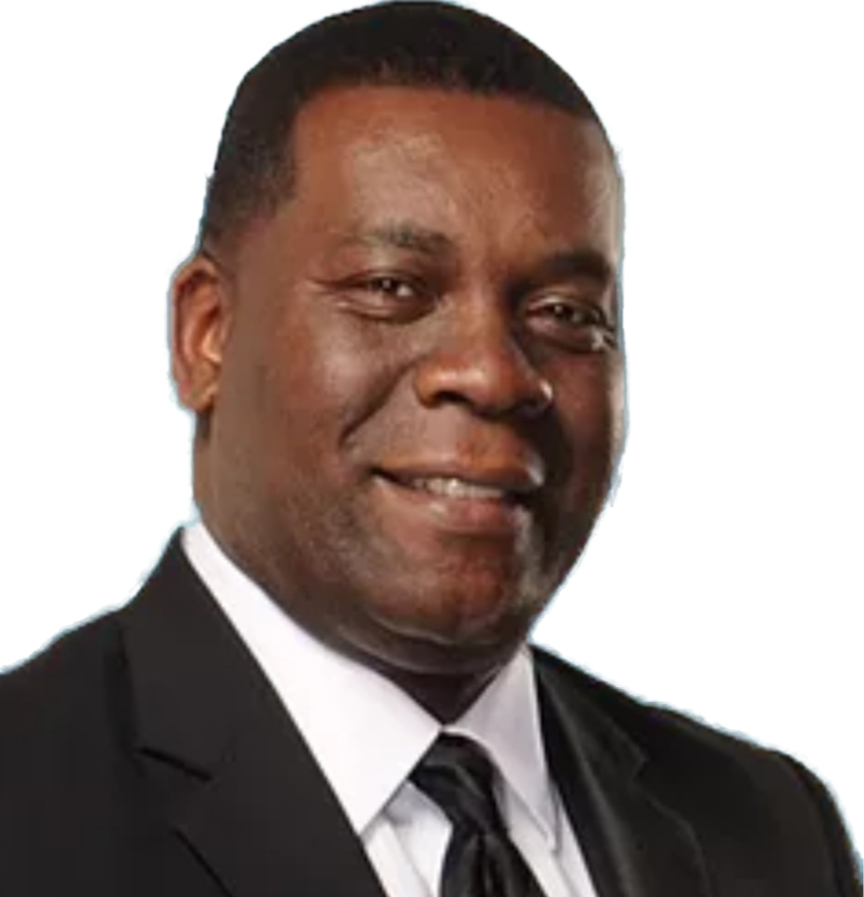
Committee reflections on why we committed two years of Monday’s from our lives to do this work:
“This framework and plan will harness the strength of our organization, ensure momentum moves in the same way while creating intentional success and demonstrate the administrative gift within the COGIC by developing and implementing a 10 Year Strategic Plan without starting over every few years.”
Supt. Anthony Wheeler
Alabama

Slide 21
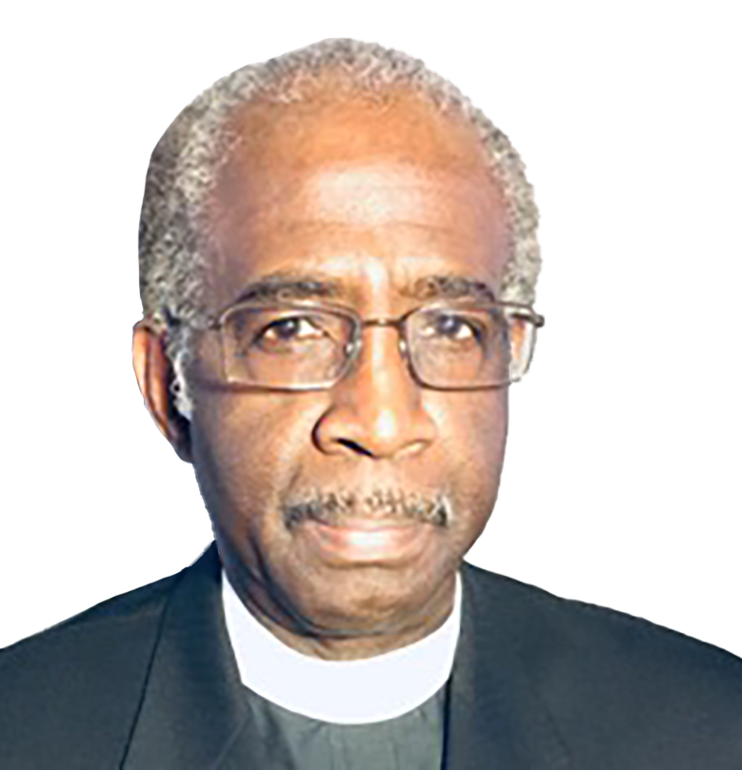
I agree with Dr. Wheeler and others that adequately answered the question "why" and request that the last sentence(s) read, "therefore this document has done so by including these seven focus areas:..." Now, it is expected that as our Executive Branch apply the the contents of this document's objectives as their Plan of Action, it is requested that our Jurisdiction leaders choose their team of strategic coordinators that will pursue these objectives locally with like-mindedness, doing so will keep the total Church synchronized and forward moving together as One Church.
Supt. Clarence Cranford
ILLINOIS

Slide 22
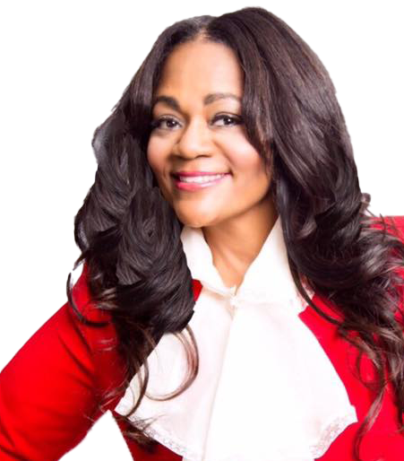
“Our why is simple…it allows us to be intentional about our culture, engagement and inclusion and ultimately take ourselves serious about experiencing planned growth.”
Evangelist Lisa Vaughn
Texas

Slide 23
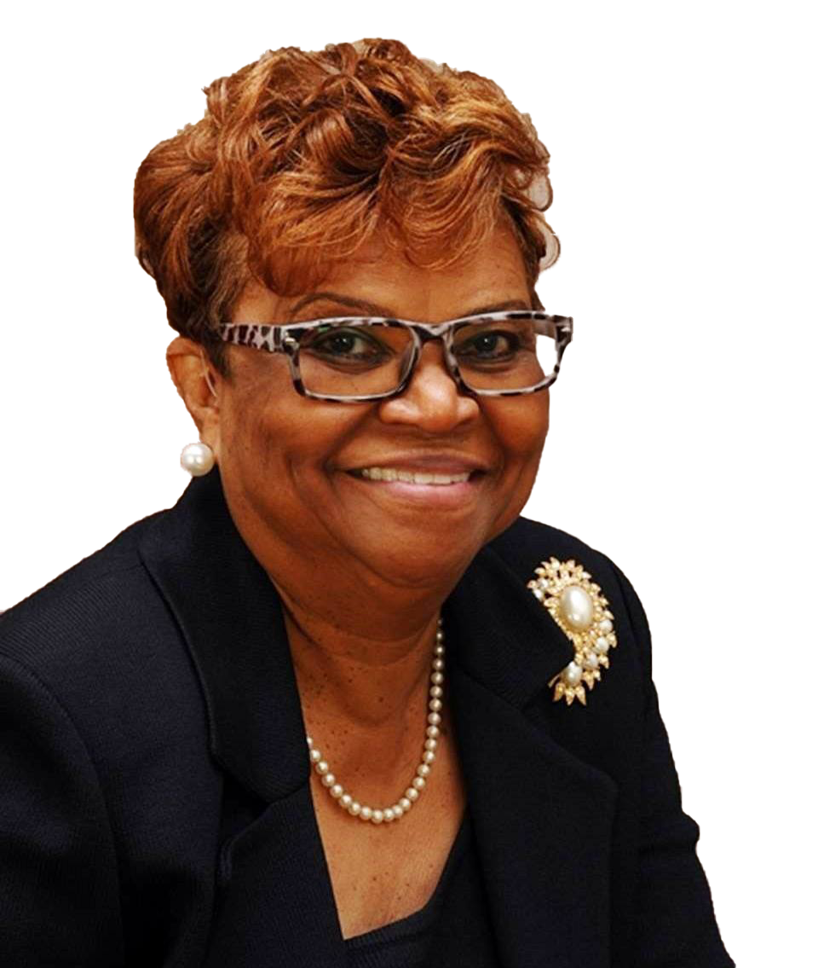
“Why did I participate? This plan ensures progressive growth and continuation of the Church of God in Christ doctrine, culture and legacy way beyond our participation.”
Dr. Goldie Wells
NORTH CAROLINA (CHMJI)

Slide 24
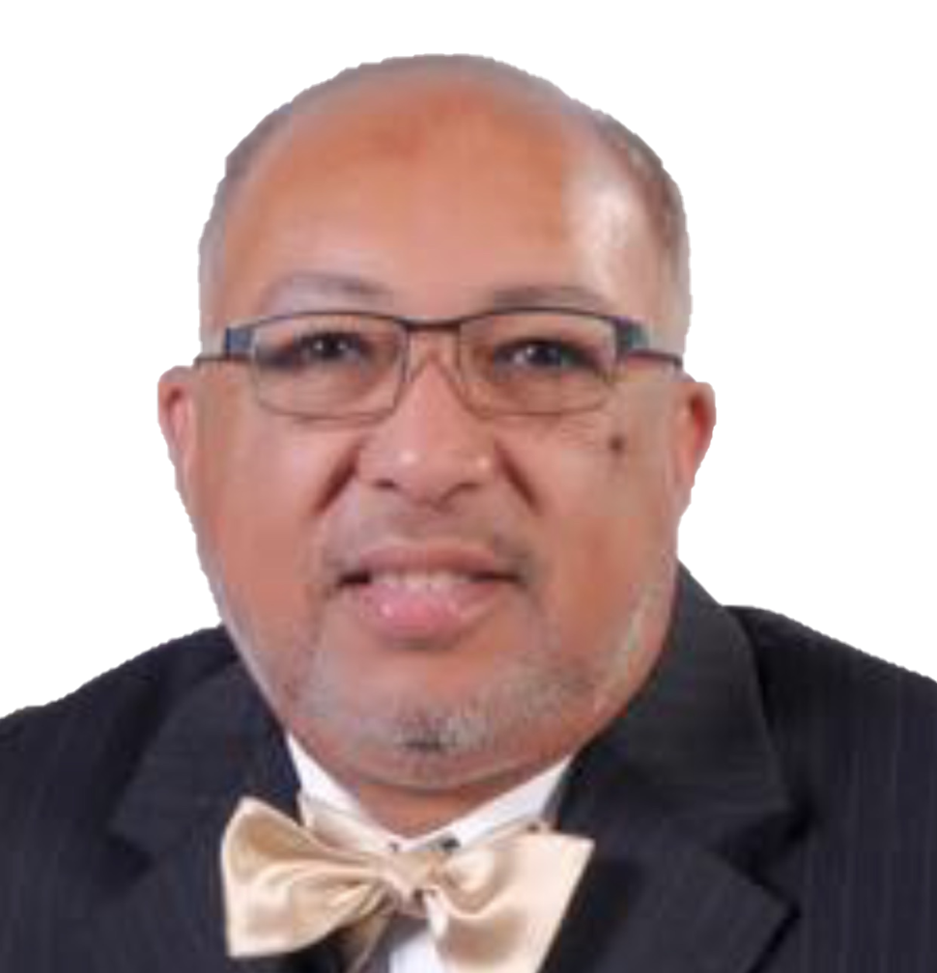
“This plan brings us all together, all of our components complementing and not competing with each other. Eliminating silo’s will permit us to set long term goals and ensures our future success as a legitimate holiness organization.
Dr. Joseph E. Fisher
Memphis (ASBC)

Slide 25
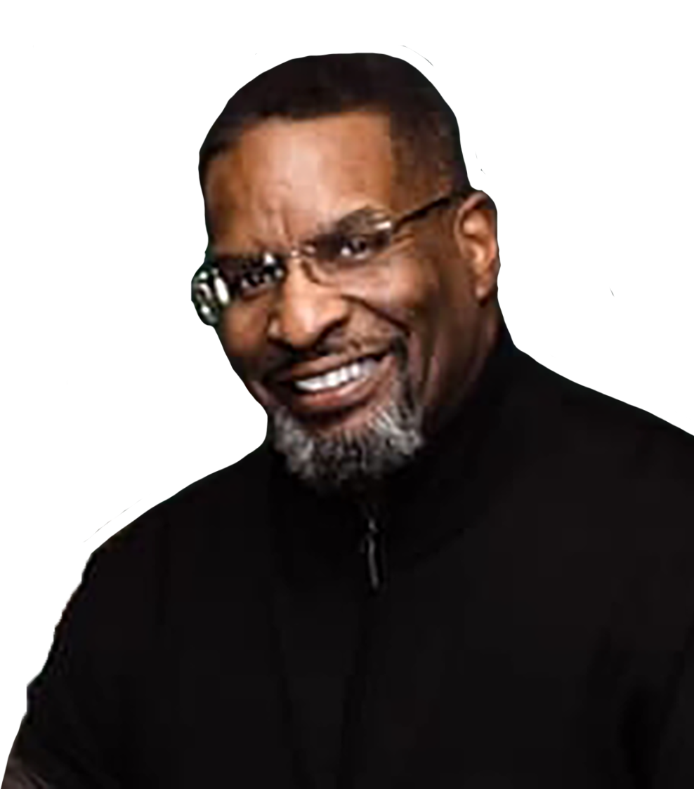
“It ensures the church is relevant in future generations demonstrating organizational consistency with visible growth measurements.”
Elder James Vaughn
Texas

Slide 26
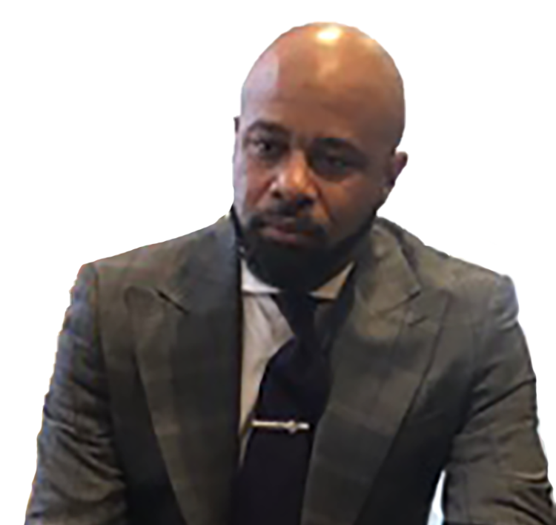
“ This plan allows us to access our status both as an organism and organization and measure our nominal impact as we create systemic success. It speaks to our purpose as our priority rather then which personalities will drive it forward.”
Elder Nic South
Michigan

Slide 27
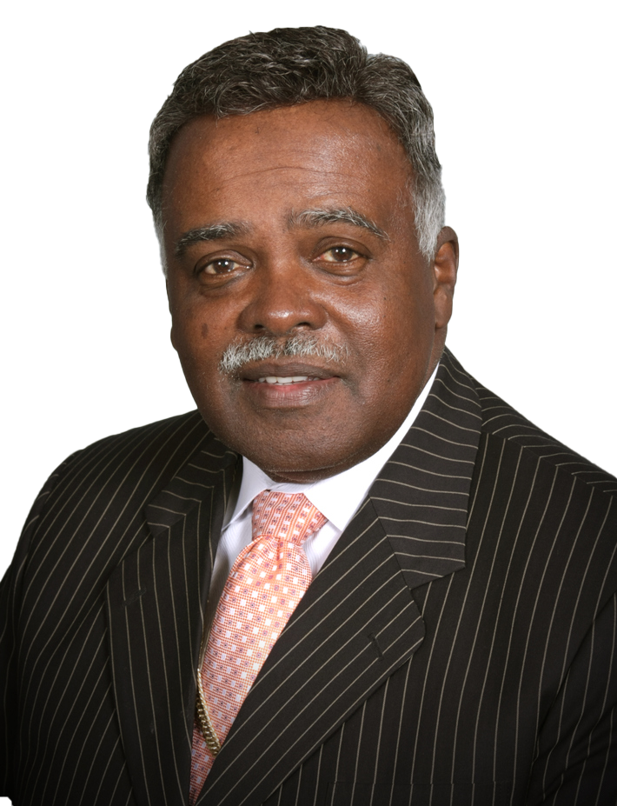
“This plan displays unified purpose through our God given potential which perpetuates holiness in a contemporary society.”
Bishop Malcolm Coby
Oklahoma

Slide 28
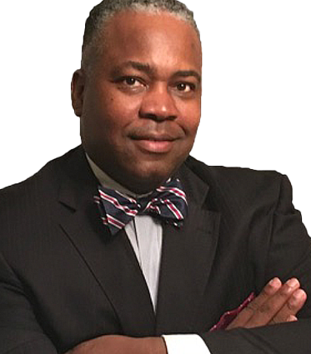
“This plan brings the full gift of administration to be incorporated in the life of the church. It allows us to act responsibly with the limited resources available and be good stewards and ends our start/stop/start issues while it galvanizes the Church of God in Christ to build our beloved community.”
Dr. Harold Bennett
Dean of C. H. Mason Seminary - Atlanta

Slide 29
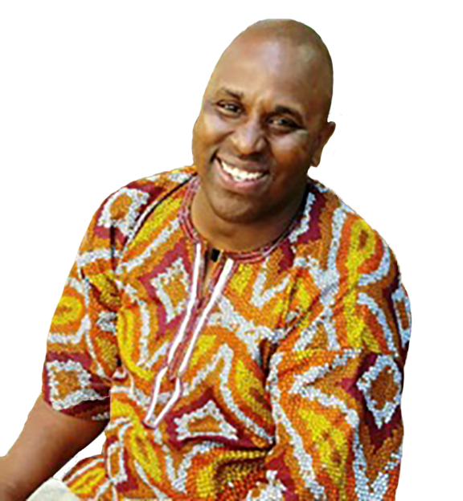
“It is congregation facing. It outlines generational equity for a great church for everyone. Forever.”
Elder Stephen Lackey
Nevada

Slide 30
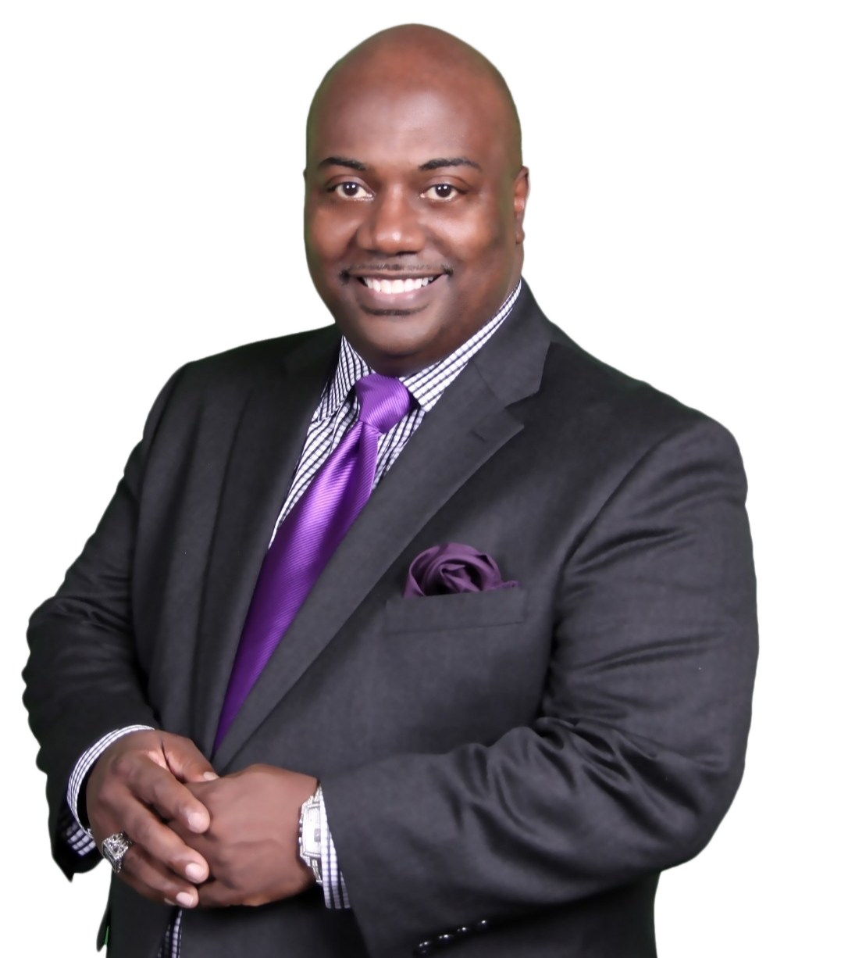
“People are more important than projects and ministry more valuable than money. Why a 10-year strategic plan? The people of the Church of God in Christ deserve it.”
Bishop Designate Matthew L. Brown
Chairman, Georgia

